Slide 1
Big Data Analytics Project
On
Fake Job Posting Prediction
GLA University
Mathura-281406 , India
Presented By:
Mukund Agrawal(181500401)
Mukul Agrawal(181500397)
Surendra Singh(181500737)
Project Mentor:
Mr. Ashutosh Shankhdhar

Slide 2
Problem Statement
Unemployment rates are increasing every single day millions of people are on the lookout for a job.
We see a daily rise in these fake job postings.
There are a lot of job advertisements on the internet, which never seem fake.

Slide 3
Objective
Classification model that uses text data and predict which job are fraudulent or real.
Identify words, entities, phrases of job which are fraudulent in nature.
Perform Exploratory Data Analysis on the dataset.

Slide 4
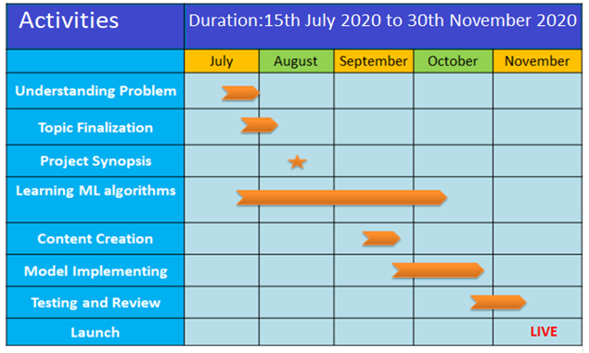
Gantt Chart

Slide 5
Implementation Technology
Hardware Requirement:
RAM: 4 GB
Processor: i3
Software Requirement:
Spyder(Anaconda3)
Algorithm Used :
Various ML Classification algorithms
Libraries Used :
Numpy
Pandas
Spacy
Sklearn

Slide 6
Dataset Details
Dataset of 18K job descriptions compiled . This dataset contains 800 fake job descriptions.
Important variables in dataset:
Title:
Location:
Company profile:
Description:
Requirements:
Benefits:
[Real or Fake] Fake JobPosting Prediction
Link-https://www.kaggle.com/shivamb/real-or-fake-fake-jobposting-prediction

Slide 7
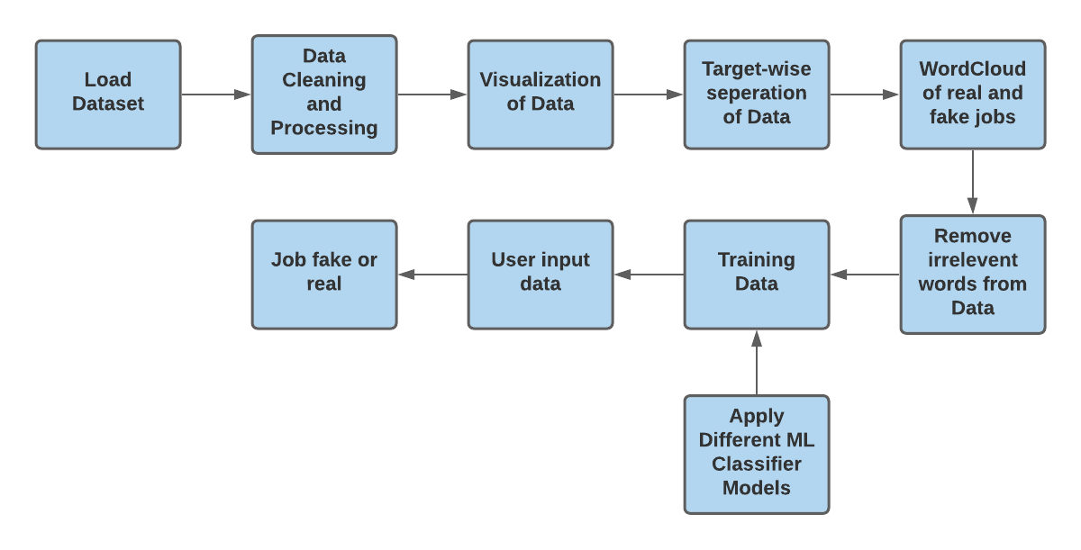
Approach:-

Slide 8
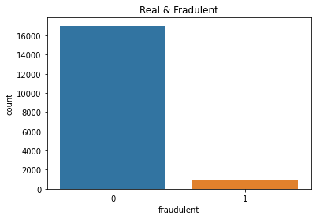
Fraud and Real visualization
sns.countplot(data.fraudulent).set_title('Real & Fradulent')
data.groupby('fraudulent').count()['title'].reset_index().sort_values(by='title',ascending=False)

Slide 9
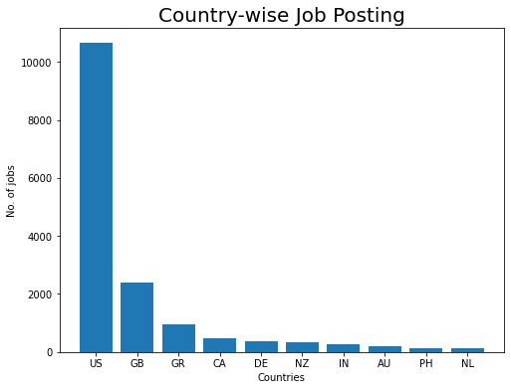
Visualize Job posting by countries
plt.figure(figsize=(8,6))
plt.title('Country-wise Job Posting', size=20)
plt.bar(country.keys(), country.values())
plt.ylabel('No. of jobs', size=10)
plt.xlabel('Countries', size=10)

Slide 10
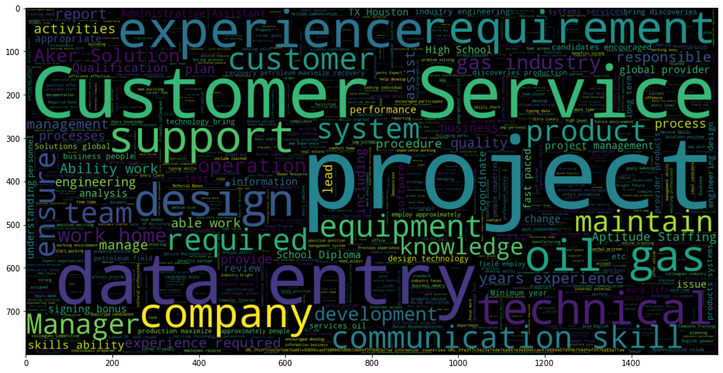
Fraudulent jobs word cloud
STOPWORDS = spacy.lang.en.stop_words.STOP_WORDS plt.figure(figsize = (16,14)) wc = WordCloud(min_font_size = 3, max_words = 3000 , width = 1600 , height = 800 , stopwords = STOPWORDS).generate(str(" ".join(fraudjobs_text))) plt.imshow(wc,interpolation = 'bilinear')

Slide 11
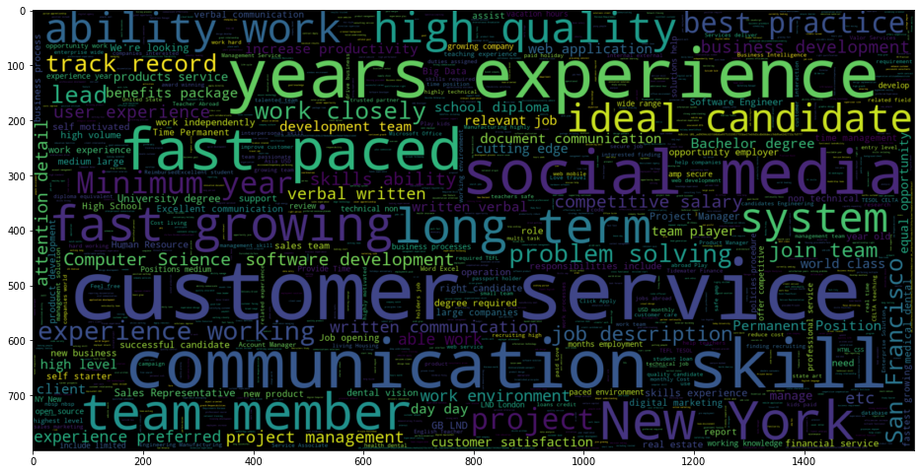
Actual jobs word cloud
STOPWORDS = spacy.lang.en.stop_words.STOP_WORDS plt.figure(figsize = (16,14)) wc = WordCloud(min_font_size = 3, max_words = 3000 , width = 1600 , height = 800 , stopwords = STOPWORDS).generate(str(" ".join(actualjobs_text))) plt.imshow(wc,interpolation = 'bilinear')

Slide 12
Various ML Classification algorithms
Support Vector Classifier
k-Nearest Neighbors
logistic regression
Decision Tree Classifier
RandomForestClassifier

Slide 13
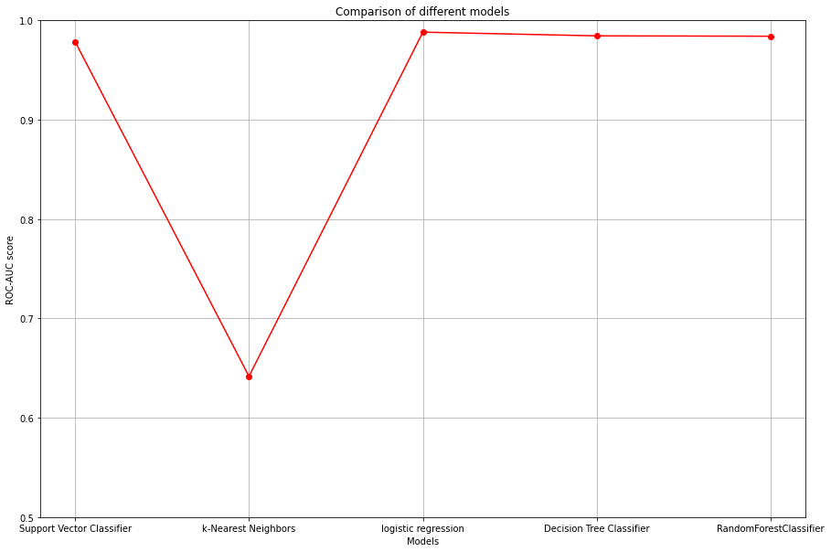
Result
 | Model_Applied | Accuracy
0 | Support Vector Classifier | 0.978561
1 | k-Nearest Neighbors | 0.641685
2 | logistic regression | 0.988069
3 | Decision Tree Classifier | 0.984340
4 | RandomForestClassifier | 0.983967
Model Accuracy table
Accuracy graph

Slide 14
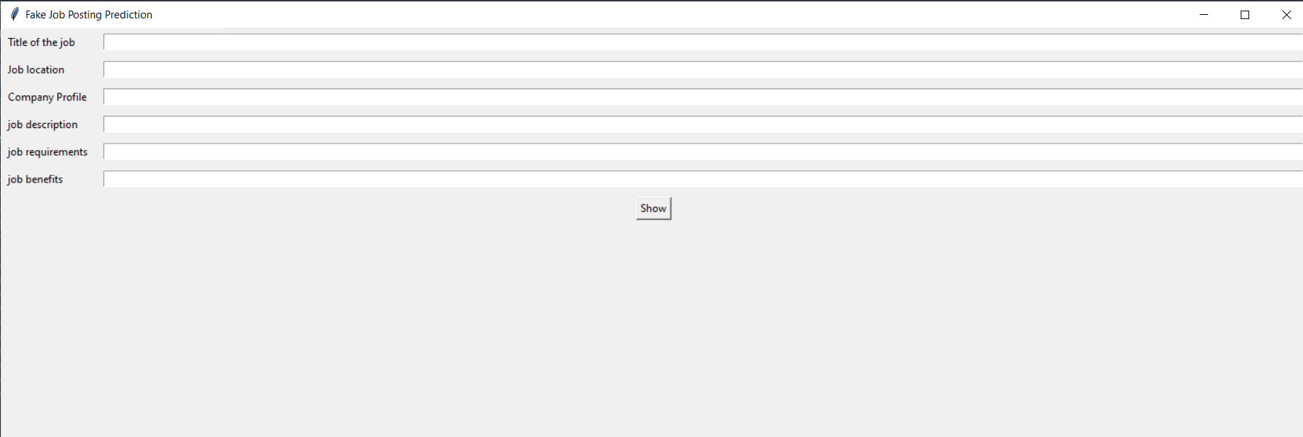
User Interface

Slide 15
Advantages
Accessible anytime
Handling Capacity
User Interface
differentiate between jobs
Can acess any time
Communicate miltiple Users
Friendly user interface
User can see fake and real job posts

Slide 16
Thank You

